Slide 1
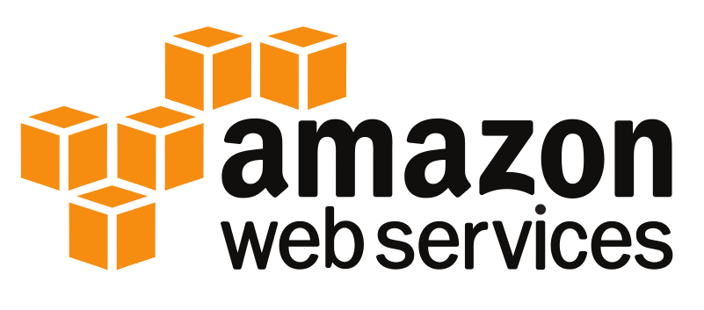
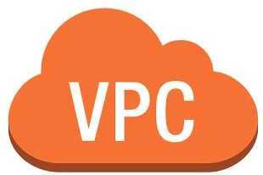
Section # 2
Introduction to AWS Terminologies
VPC

Slide 2
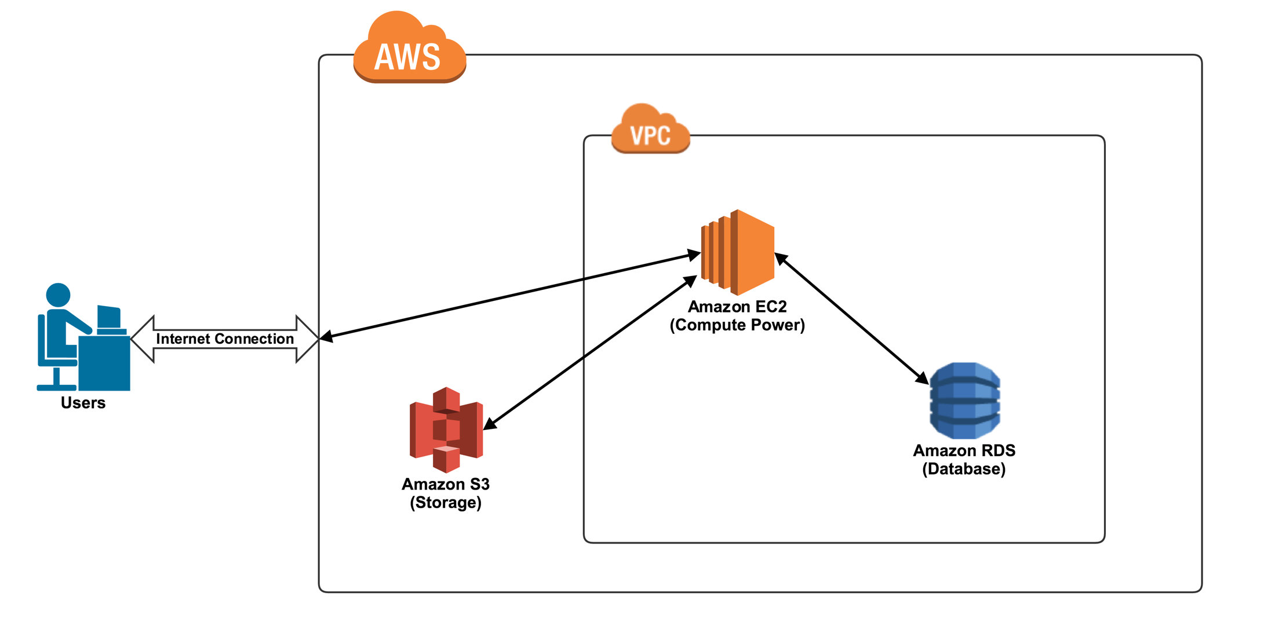
Introduction to AWS Terminologies
To provide a high level introduction to Amazon Web Services using oversimplification of concepts for the purpose of providing a frame of reference for you to move forward.

Slide 3
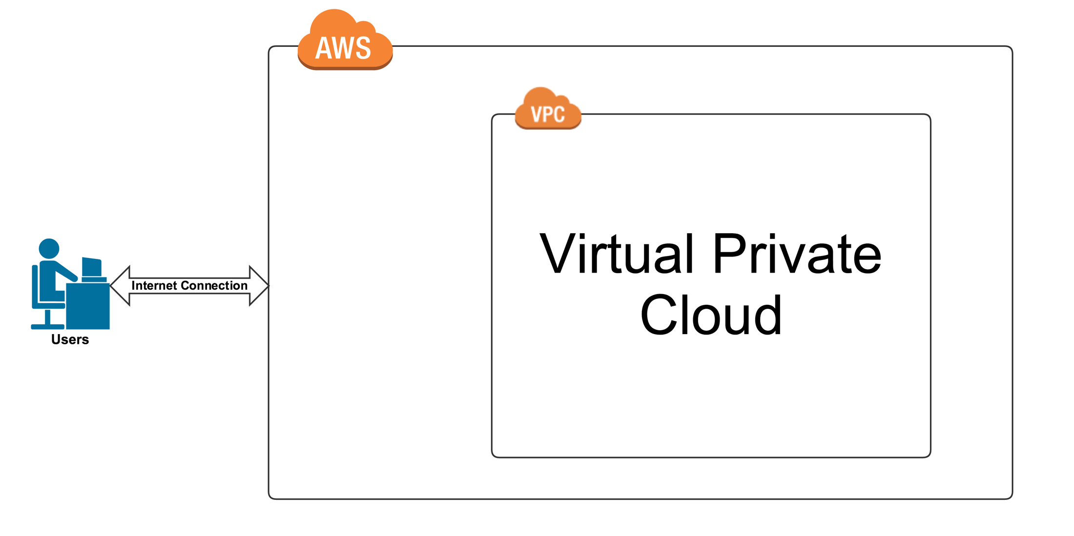
What is VPC
What is a virtual private cloud.
What does that mean for you.

Slide 4
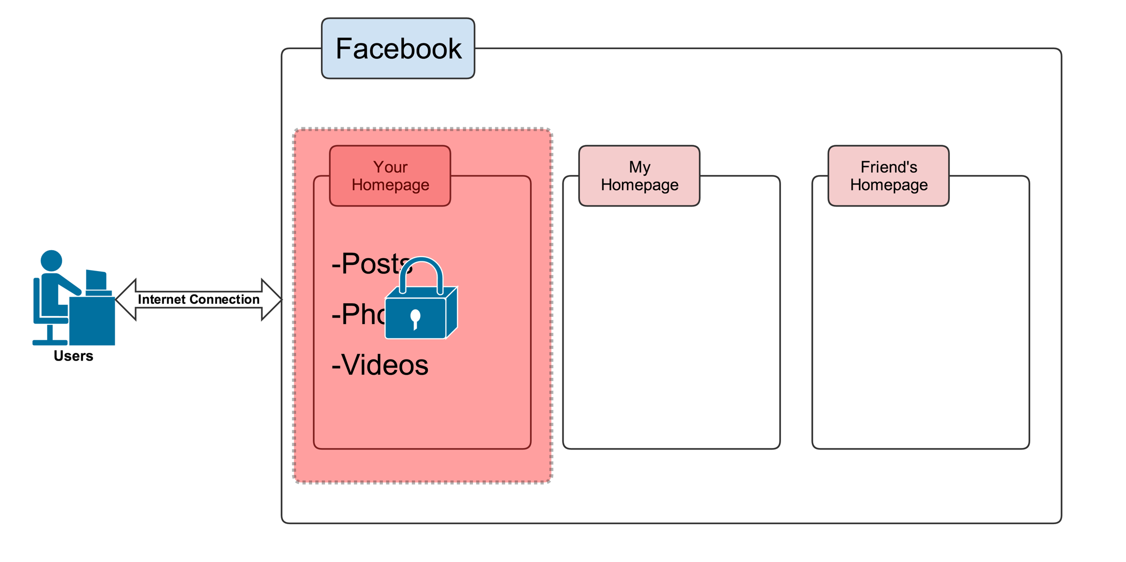
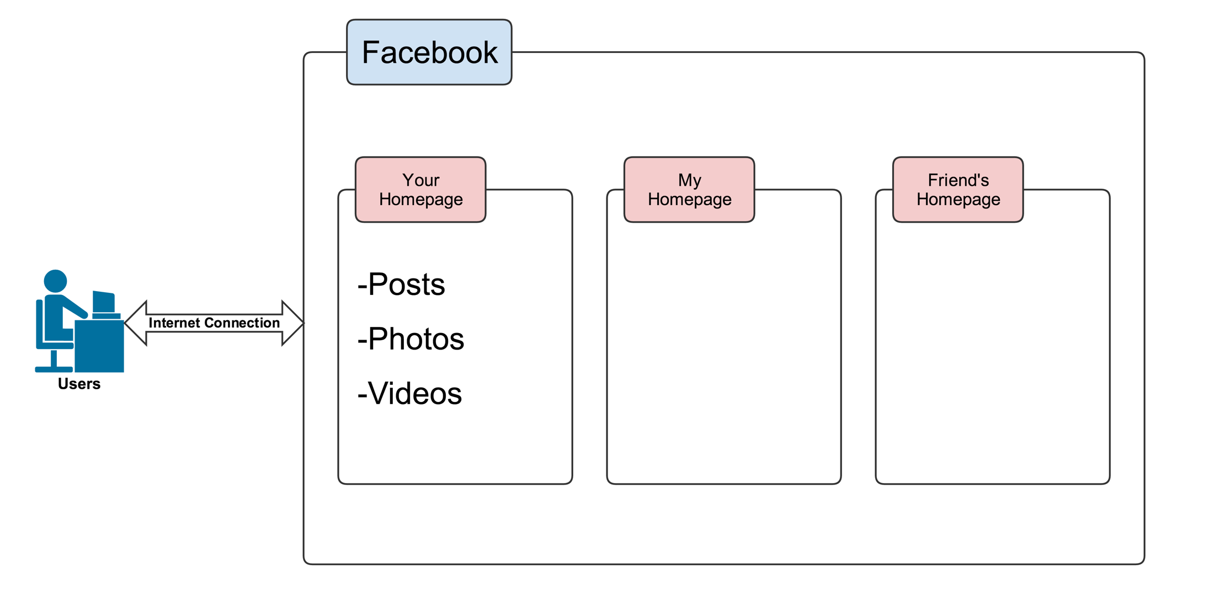
Analogy
Use Facebook here to give you a frame of reference for what VPC is.
Your home page is your own private section of Facebook where you can do things like insert, post photos and your videos.
If you want you even have a level of security on top in terms of who you allow to view your post videos or photos depending on who you allow to be your friend.
Within Facebook different people have different private sections of Facebook in which they put things like posts photos and videos as well as having a layer of security.

Slide 5
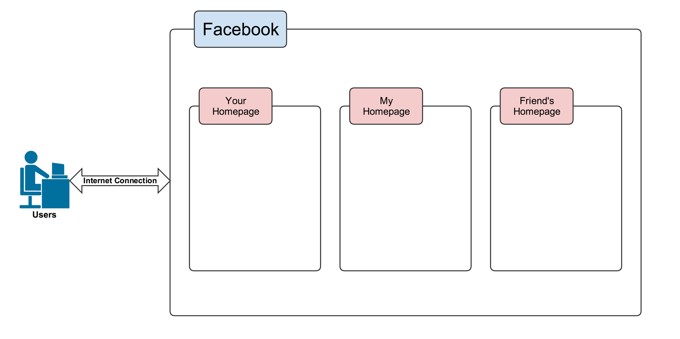
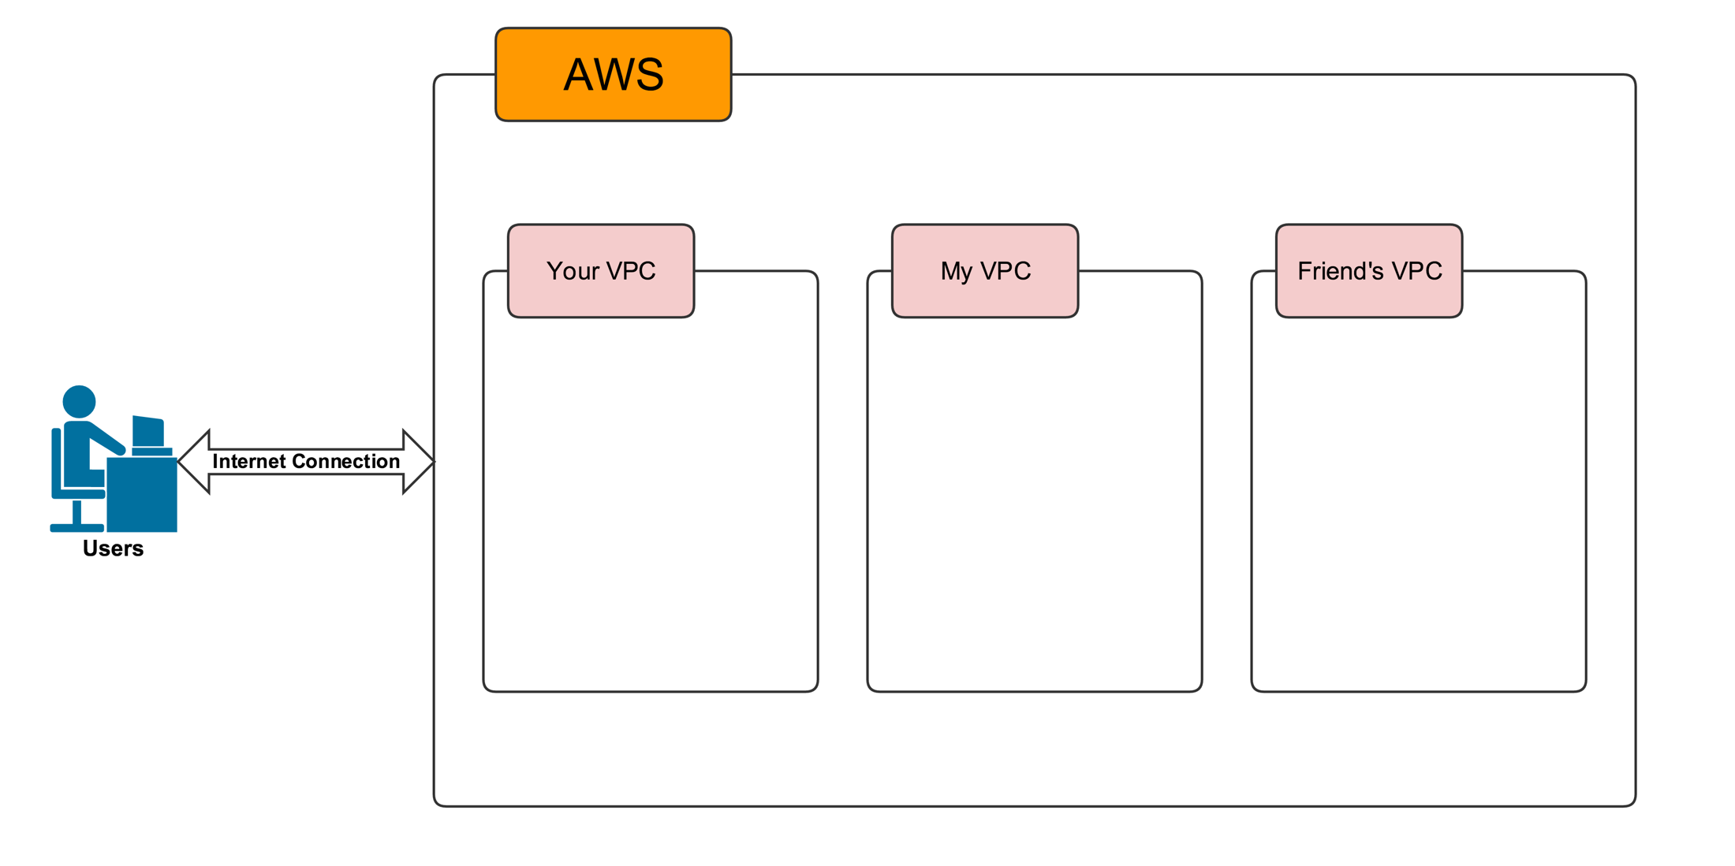
Analogy

Slide 6
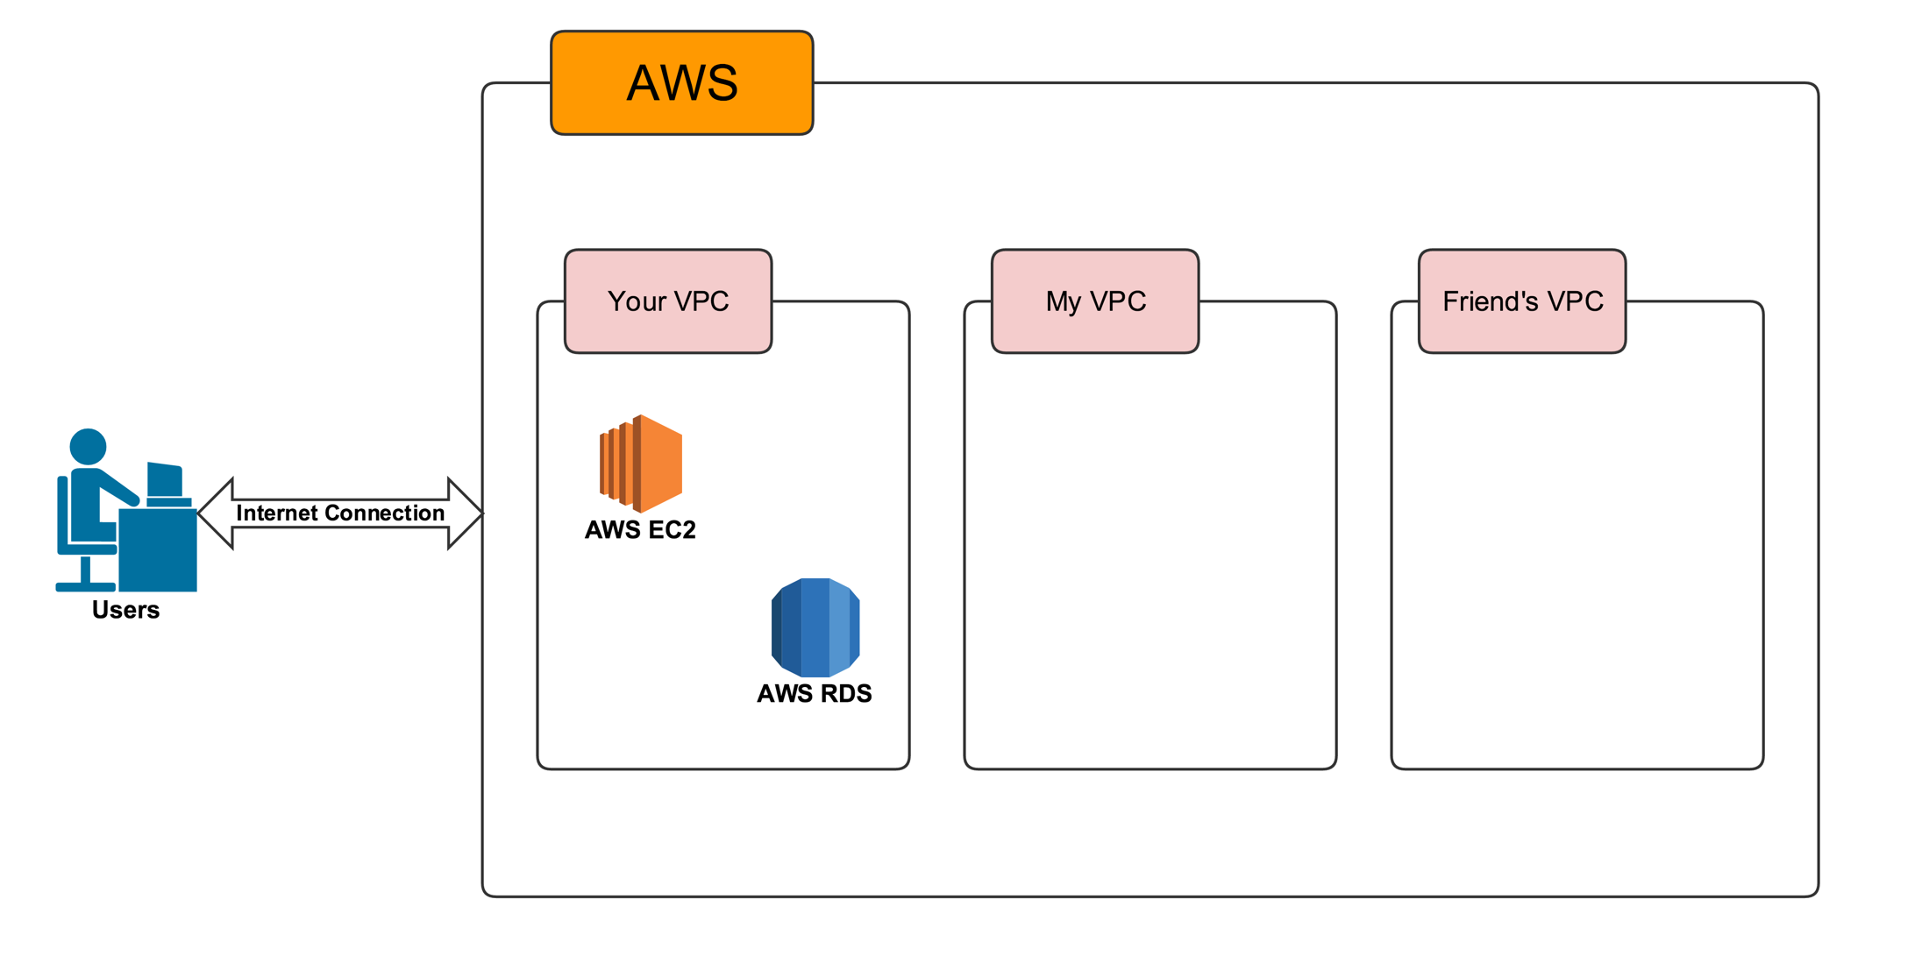
Analogy

Slide 7
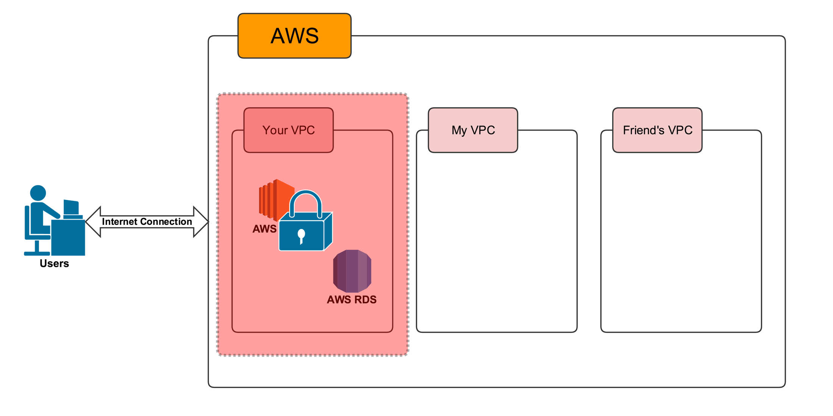
Analogy

Slide 8
Conclusion
A VPC is your Private Section of AWS.
Where you can place AWS resources, and allow/restrict to access them

Slide 9
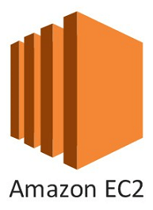
Section # 2
Introduction to AWS Terminologies
EC2

Slide 10
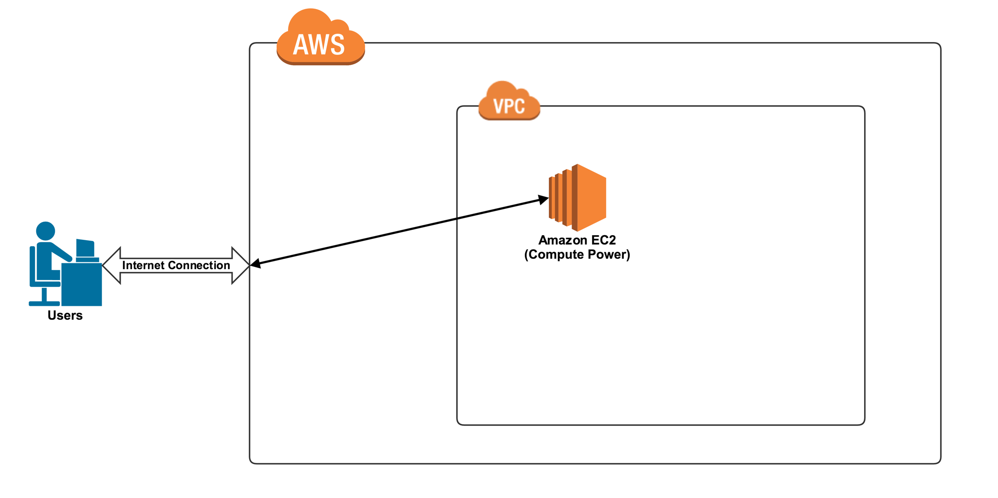
EC2 (Elastic Compute Cloud)

Slide 11
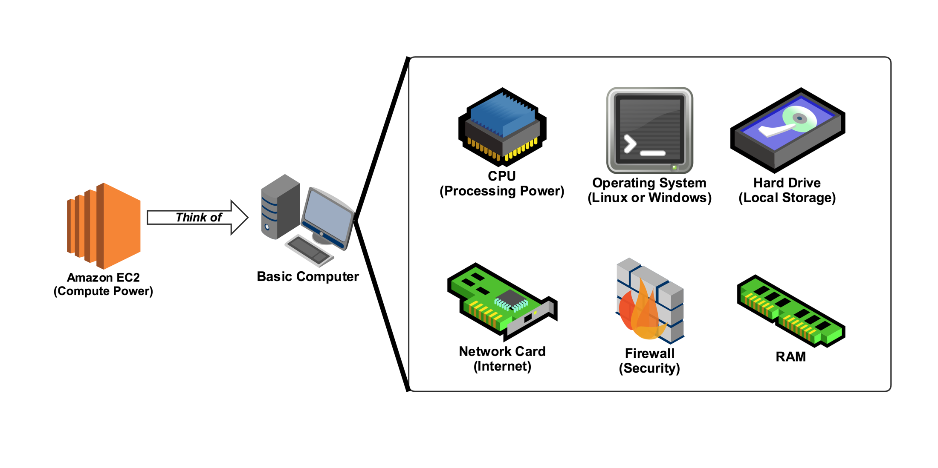
EC2 (Elastic Compute Cloud)
Think about a basic computer that's basically what EC2 is.
It's the virtual equivalent of the computer that is currently sitting in front of you.

Slide 12
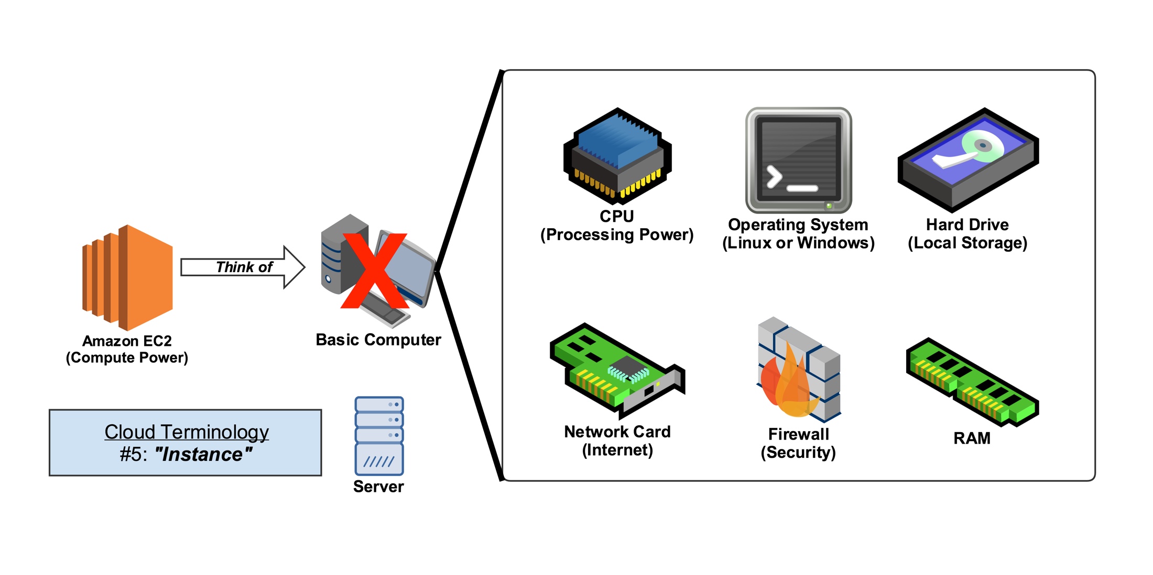
EC2 (Elastic Compute Cloud)
In terms of AWS don’t actually think about a base computer.
Think about a server computer because generally AWS is used by enterprise companies.
They're using these computers of compute power as servers.

Slide 13
Netflix
EC2 Analogy
How does Netflix specifically use EC2 ?

Slide 14
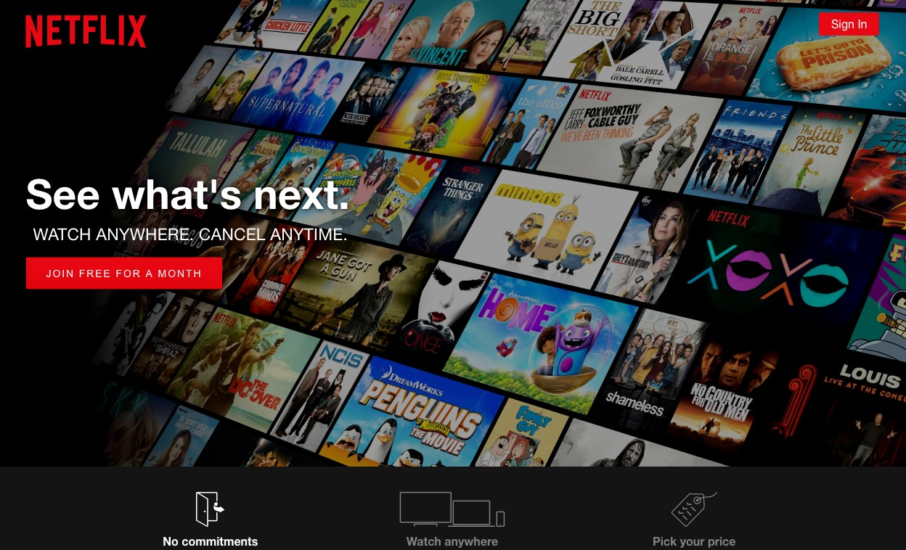
EC2 Analogy
When you go to www.Netflix.com you come to their home page and you would see something that looks exactly like this.

Slide 15
EC2 Analogy
Amazon EC2 instances doing is acting as a server or a web hosting server.
If you have an Internet connection you go to www.Netflix.com, connecting to an Amazon EC2 Instance which is currently serving as a web hosting server and that EC2 instance contains all the files and the code to give you this Web page.
www.Netflix.com

Slide 16
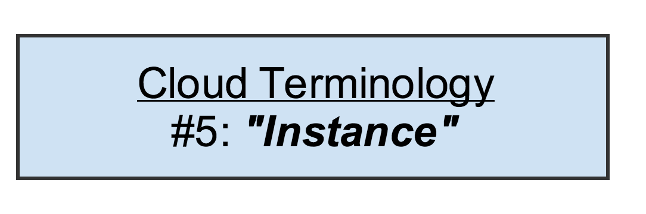
Conclusion
Think EC2 Instance as a virtual computer that you can use for whatever you like.
One of the common uses of that is as a web hosting server.
Also we introduced the cloud term Instance which is another way of referring to an EC2 server.
Amazon EC2 is good for any type of processing activity.
So whether that's web hosting whether it's an encoding transcoding whether it's something that is graphically intensive whether something that has a lot of mathematical equations going on anything that needs general basic processing EC2 is the solution that you're looking for.

Slide 17
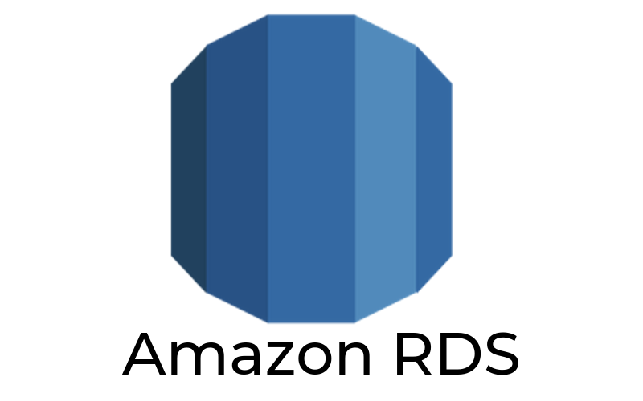
Section # 2
Introduction to AWS Terminologies
RDS

Slide 18
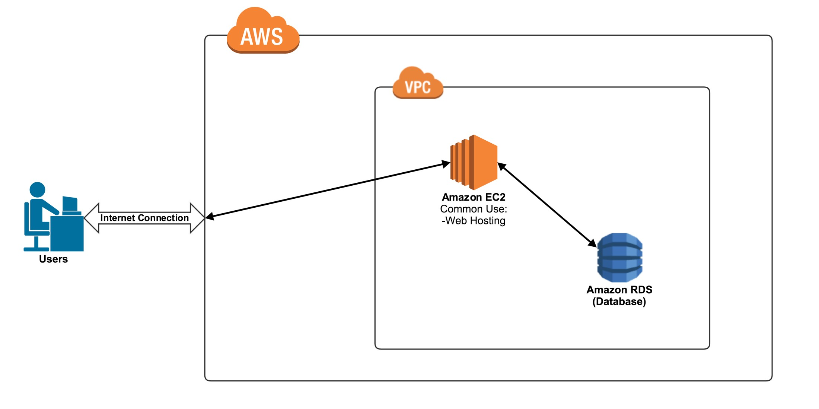
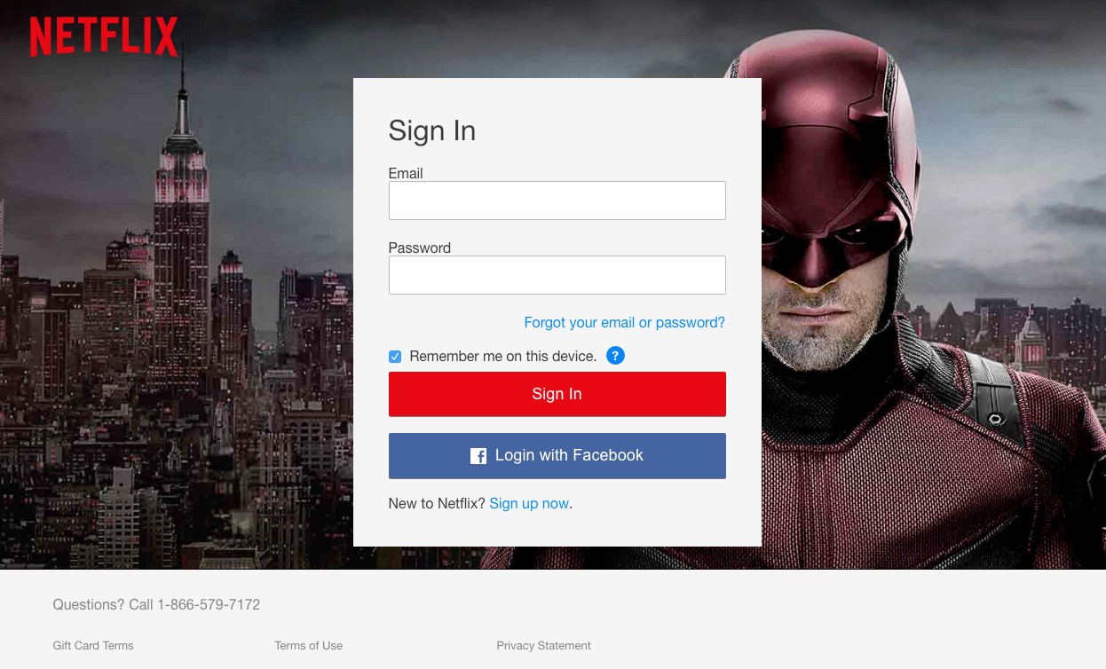
RDS (Relational Database Service)
What happens when you actually go to sign into Netflix.
You put in your credentials or you create an account.
Something has to be done with your own personal information.
This is where something like Amazon RDS comes into play.
RDS is a database platform provided by Amazon Web Services.
www.Netflix.com

Slide 19
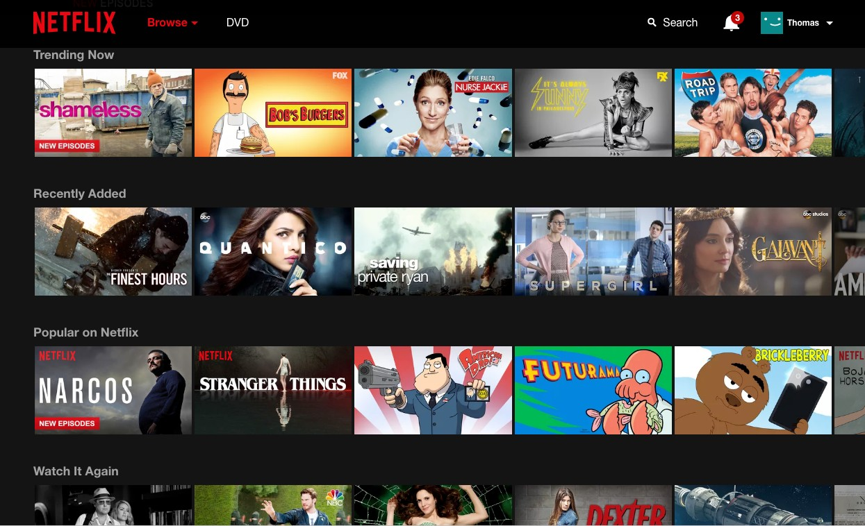
RDS (Relational Database Service)
Once you've signed, the entire list or the entire catalog of all of the shows and all of the episodes that Netflix has to offer.
www.Netflix.com

Slide 20
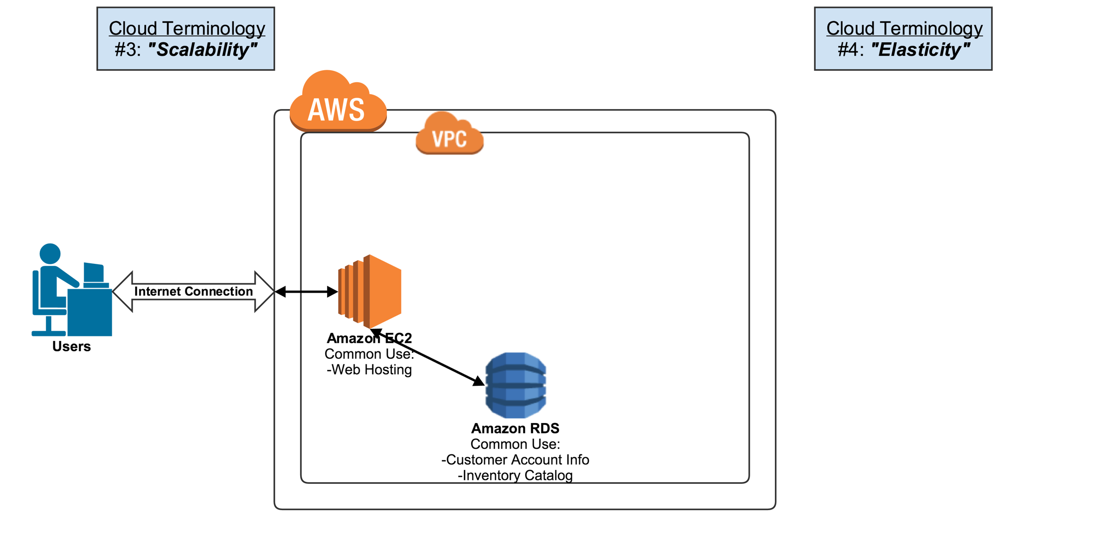
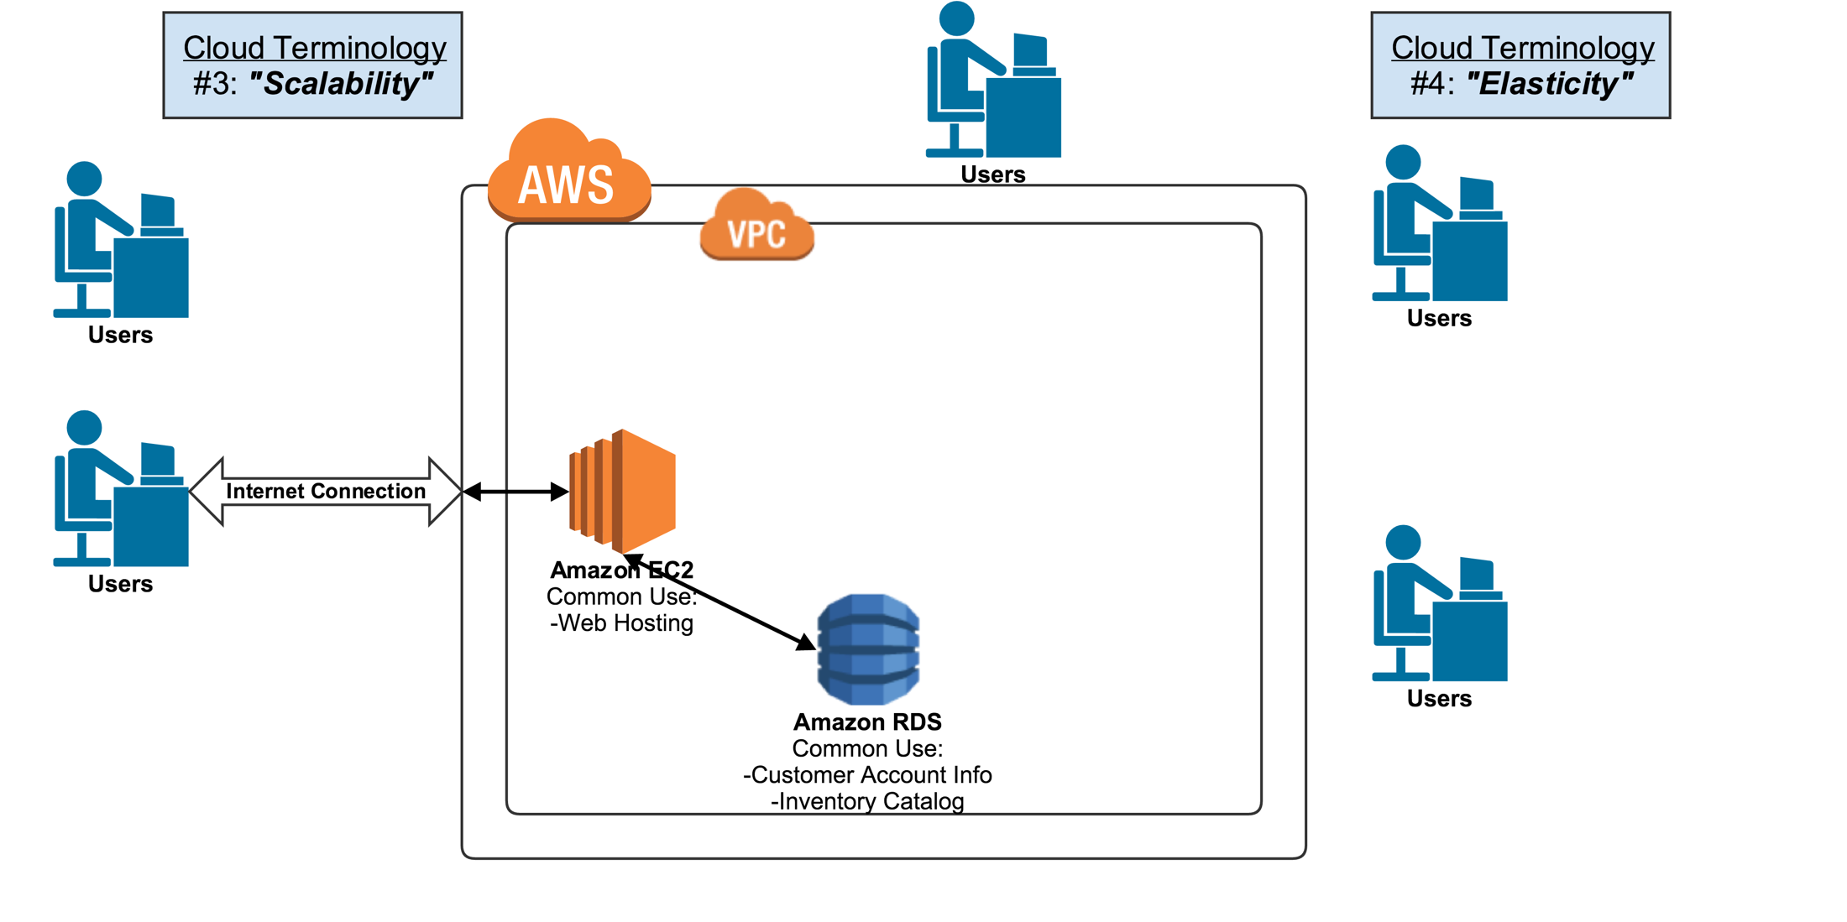
Scalability & Elasticity
At 02:00 Pm
At 08:00 Pm

Slide 21
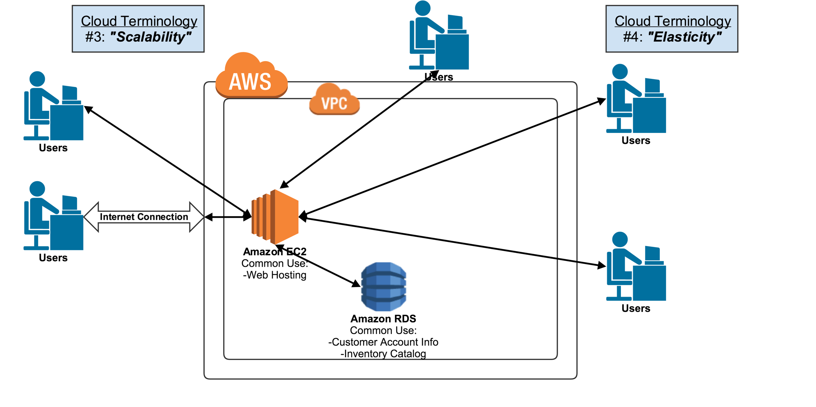

Scalability & Elasticity

Slide 22
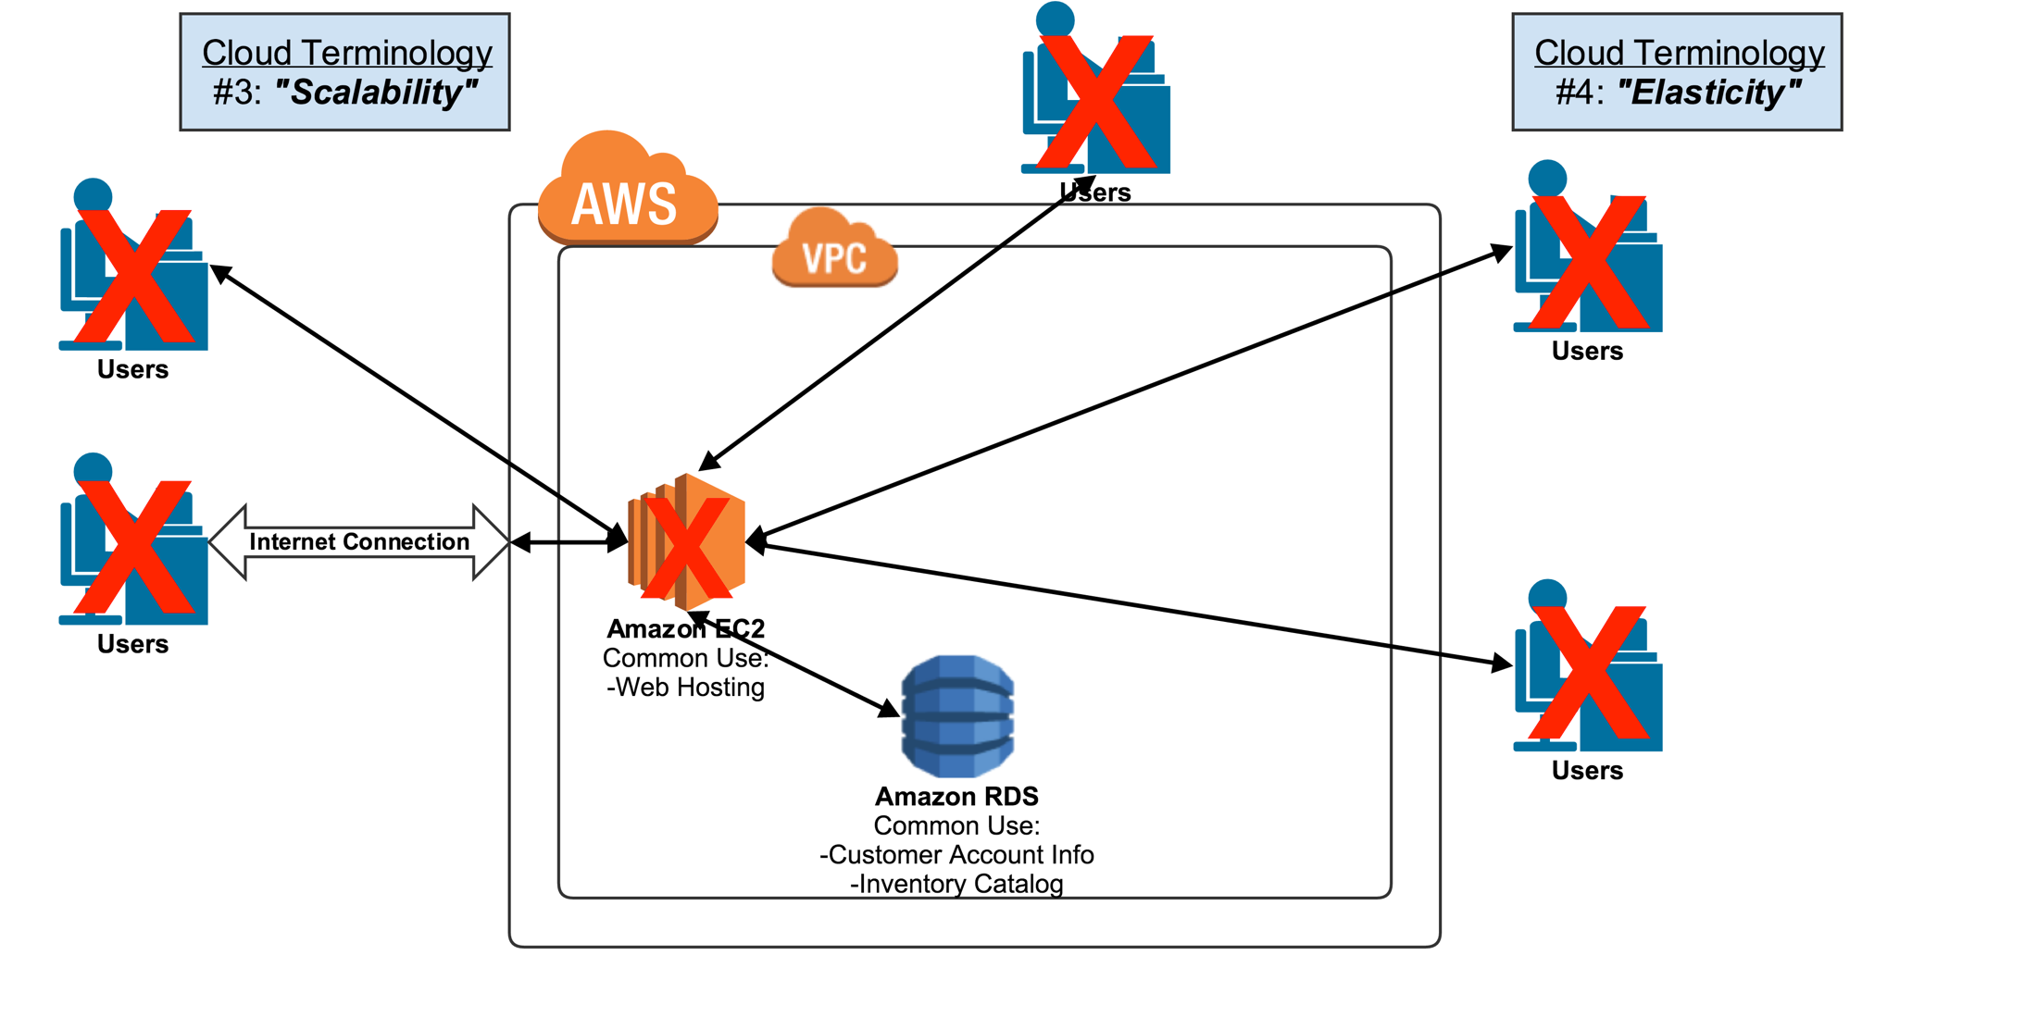
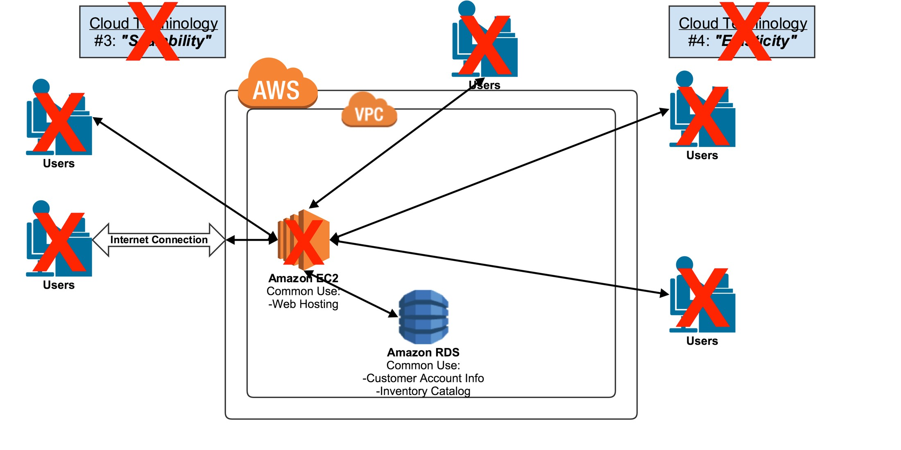
Scalability & Elasticity

Slide 23
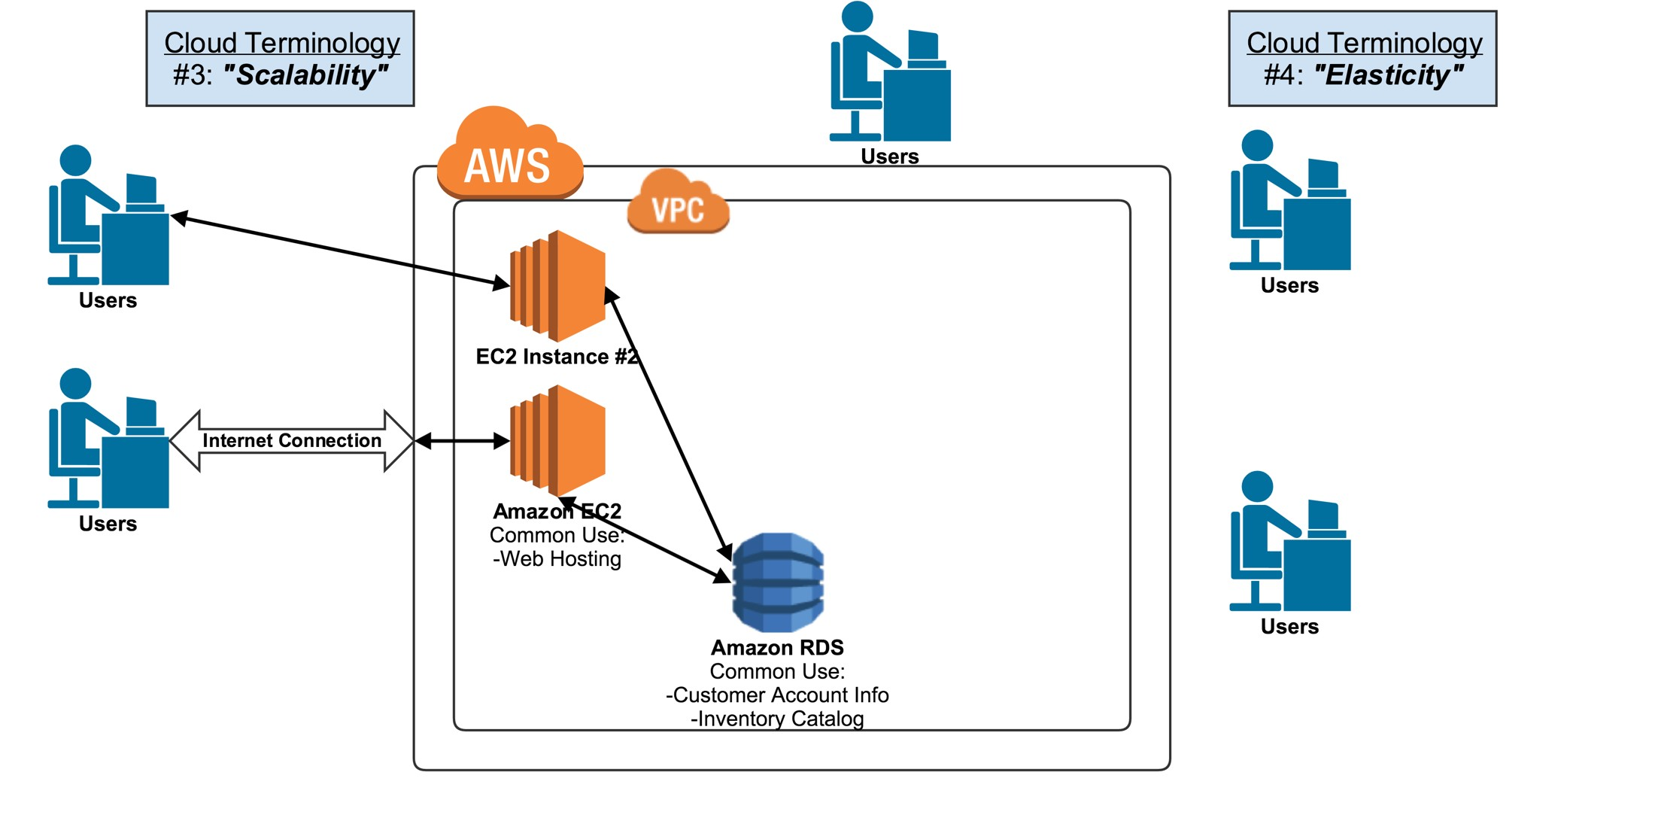
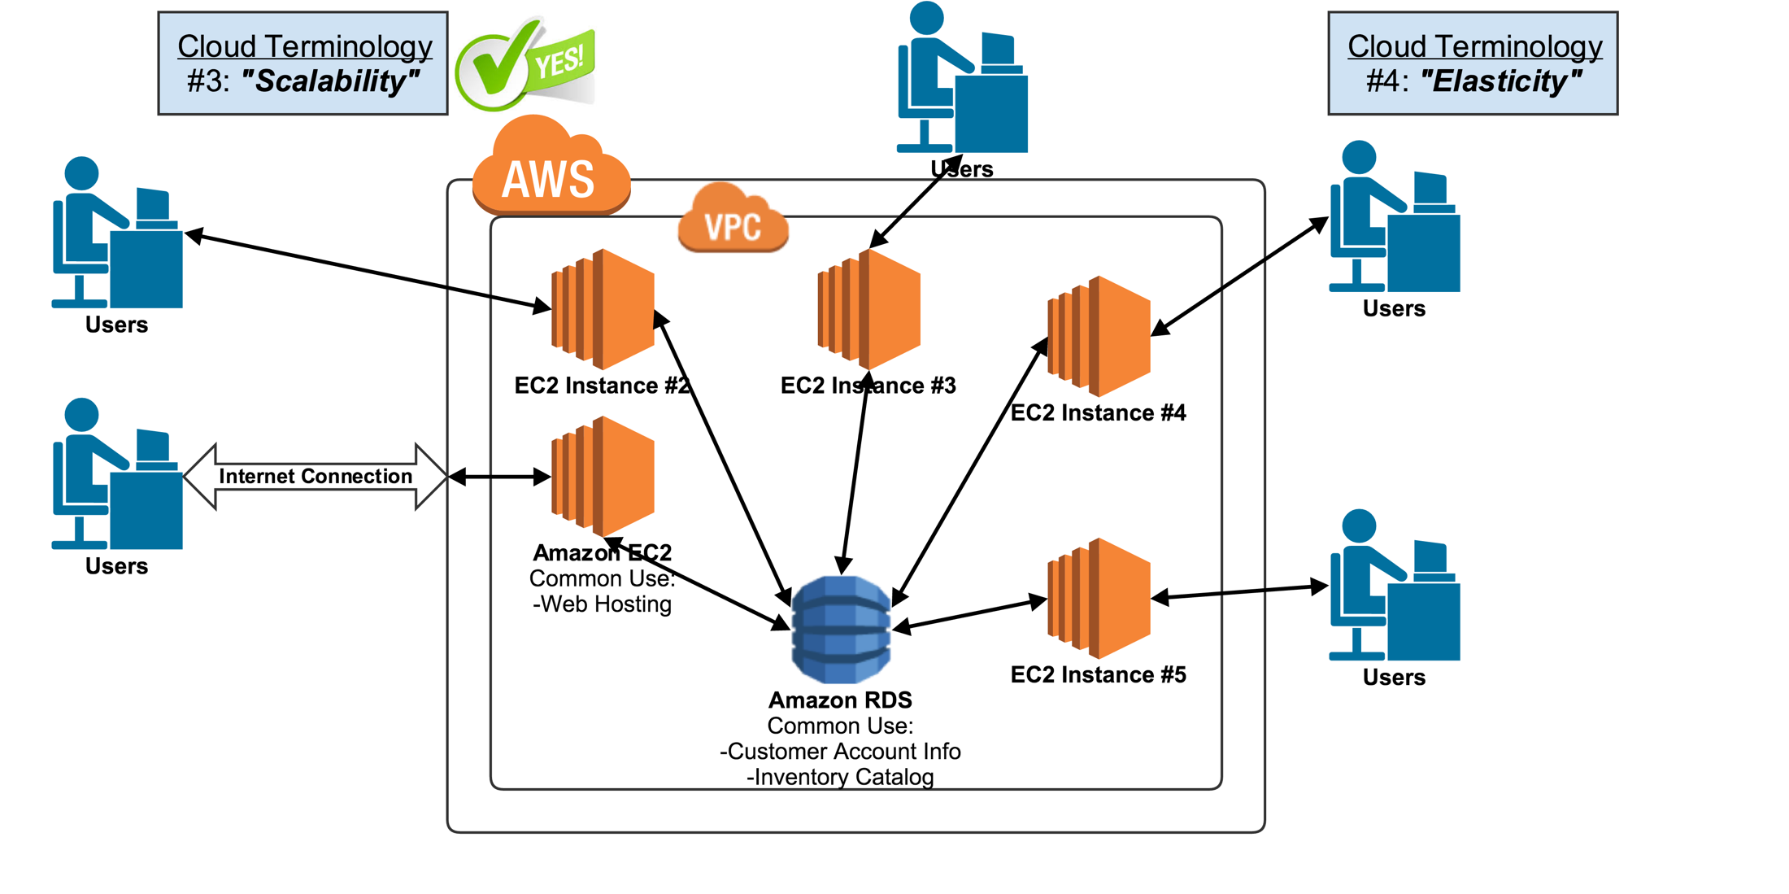
Scalability & Elasticity

Slide 24
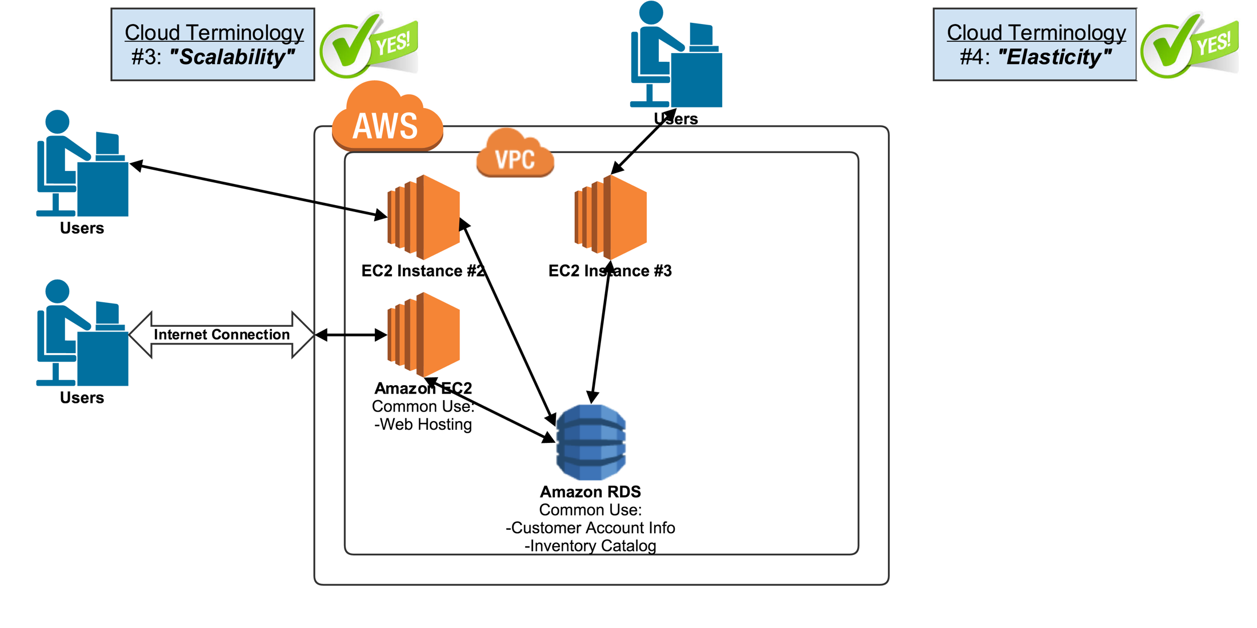
Scalability & Elasticity

Slide 25
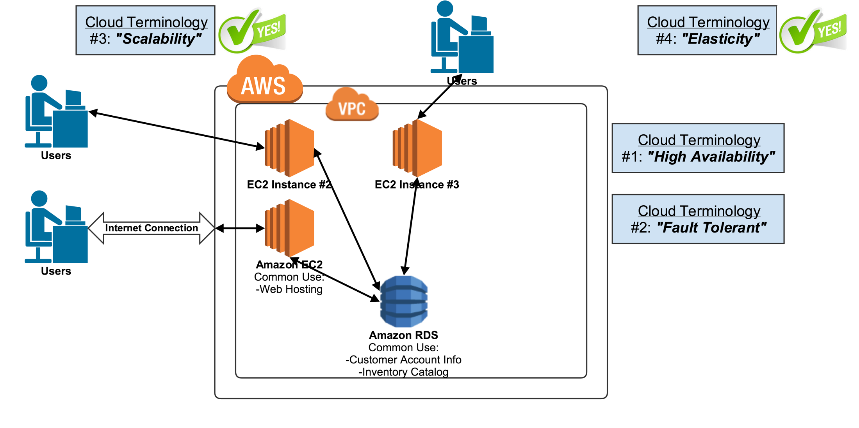
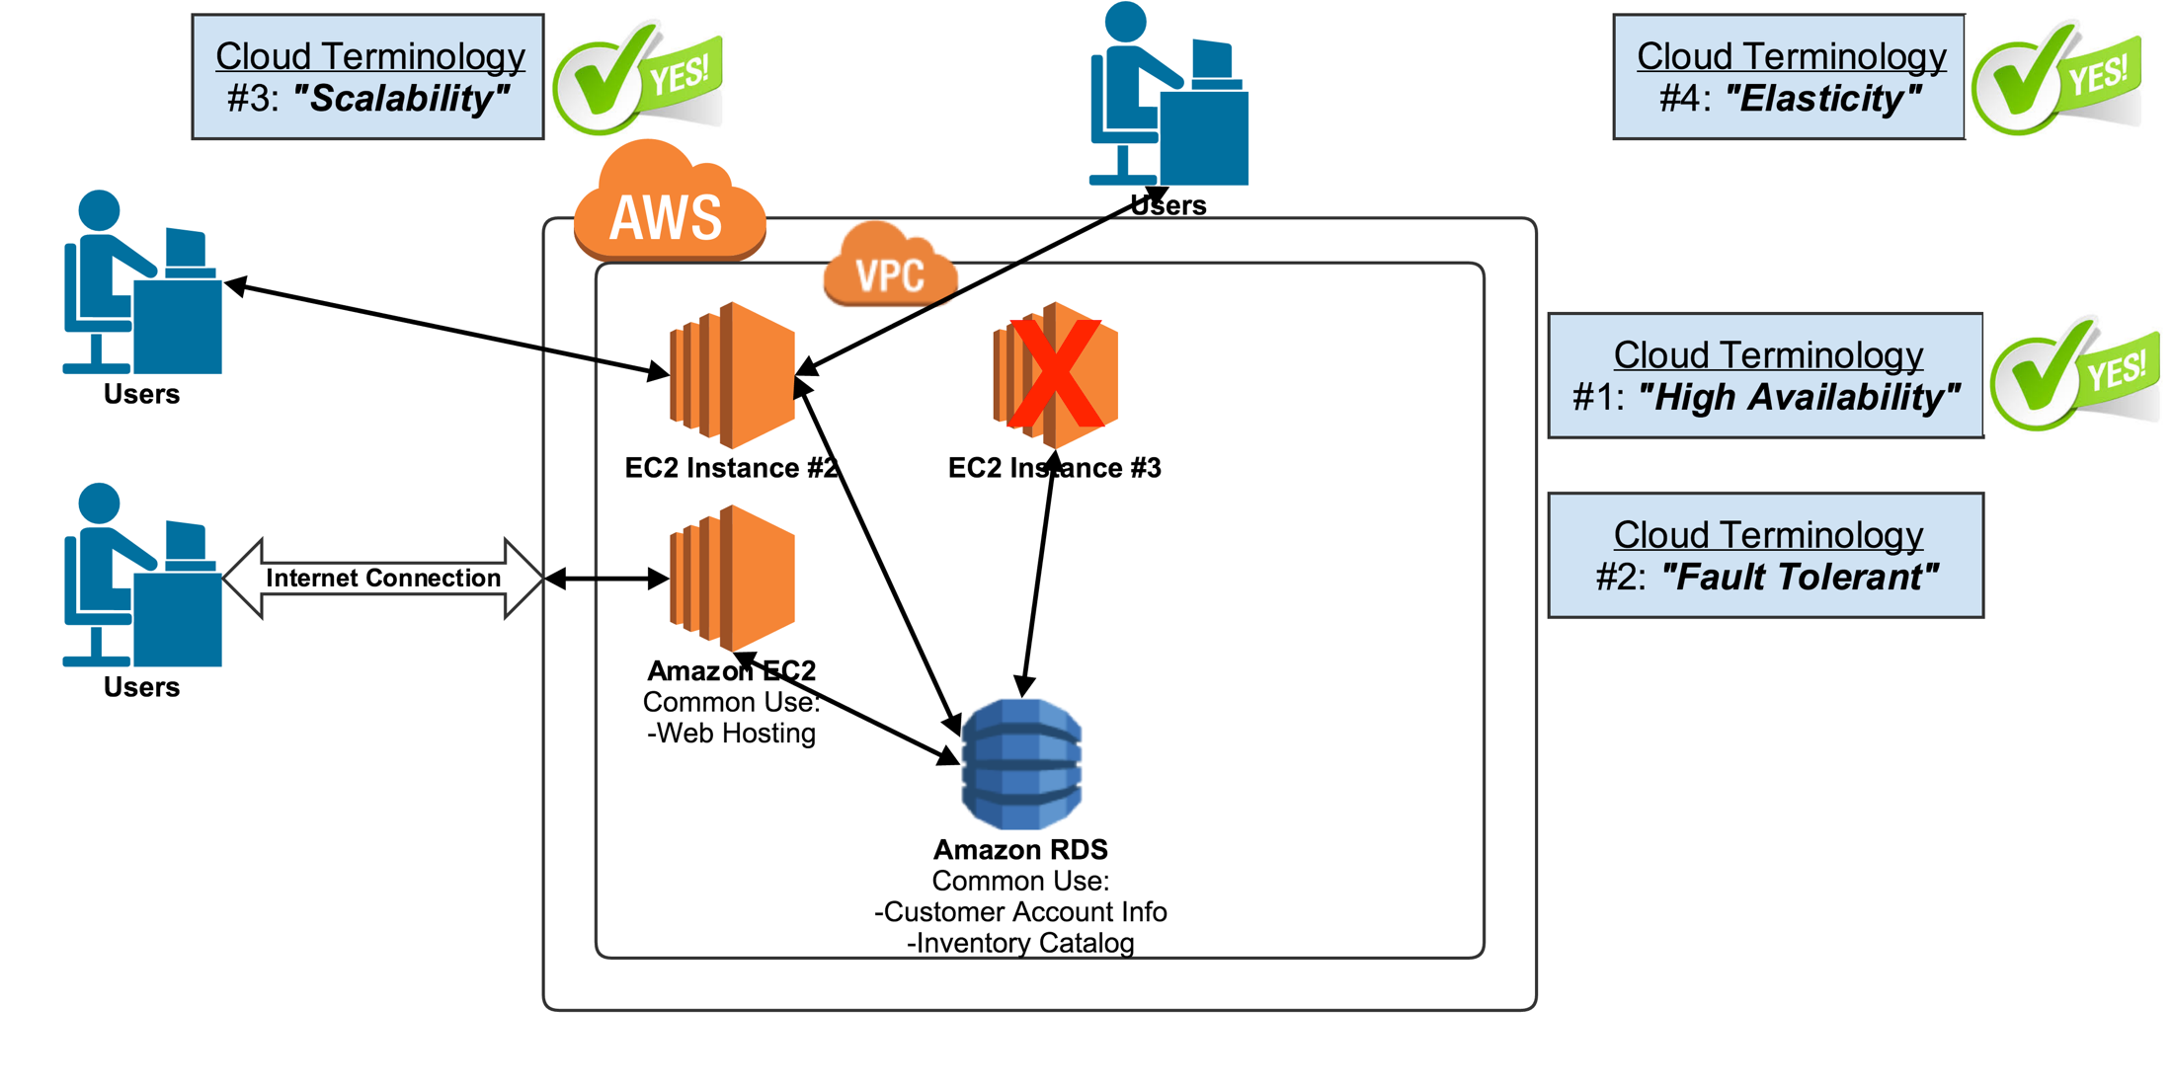
High Availability & Fault Tolerant

Slide 26
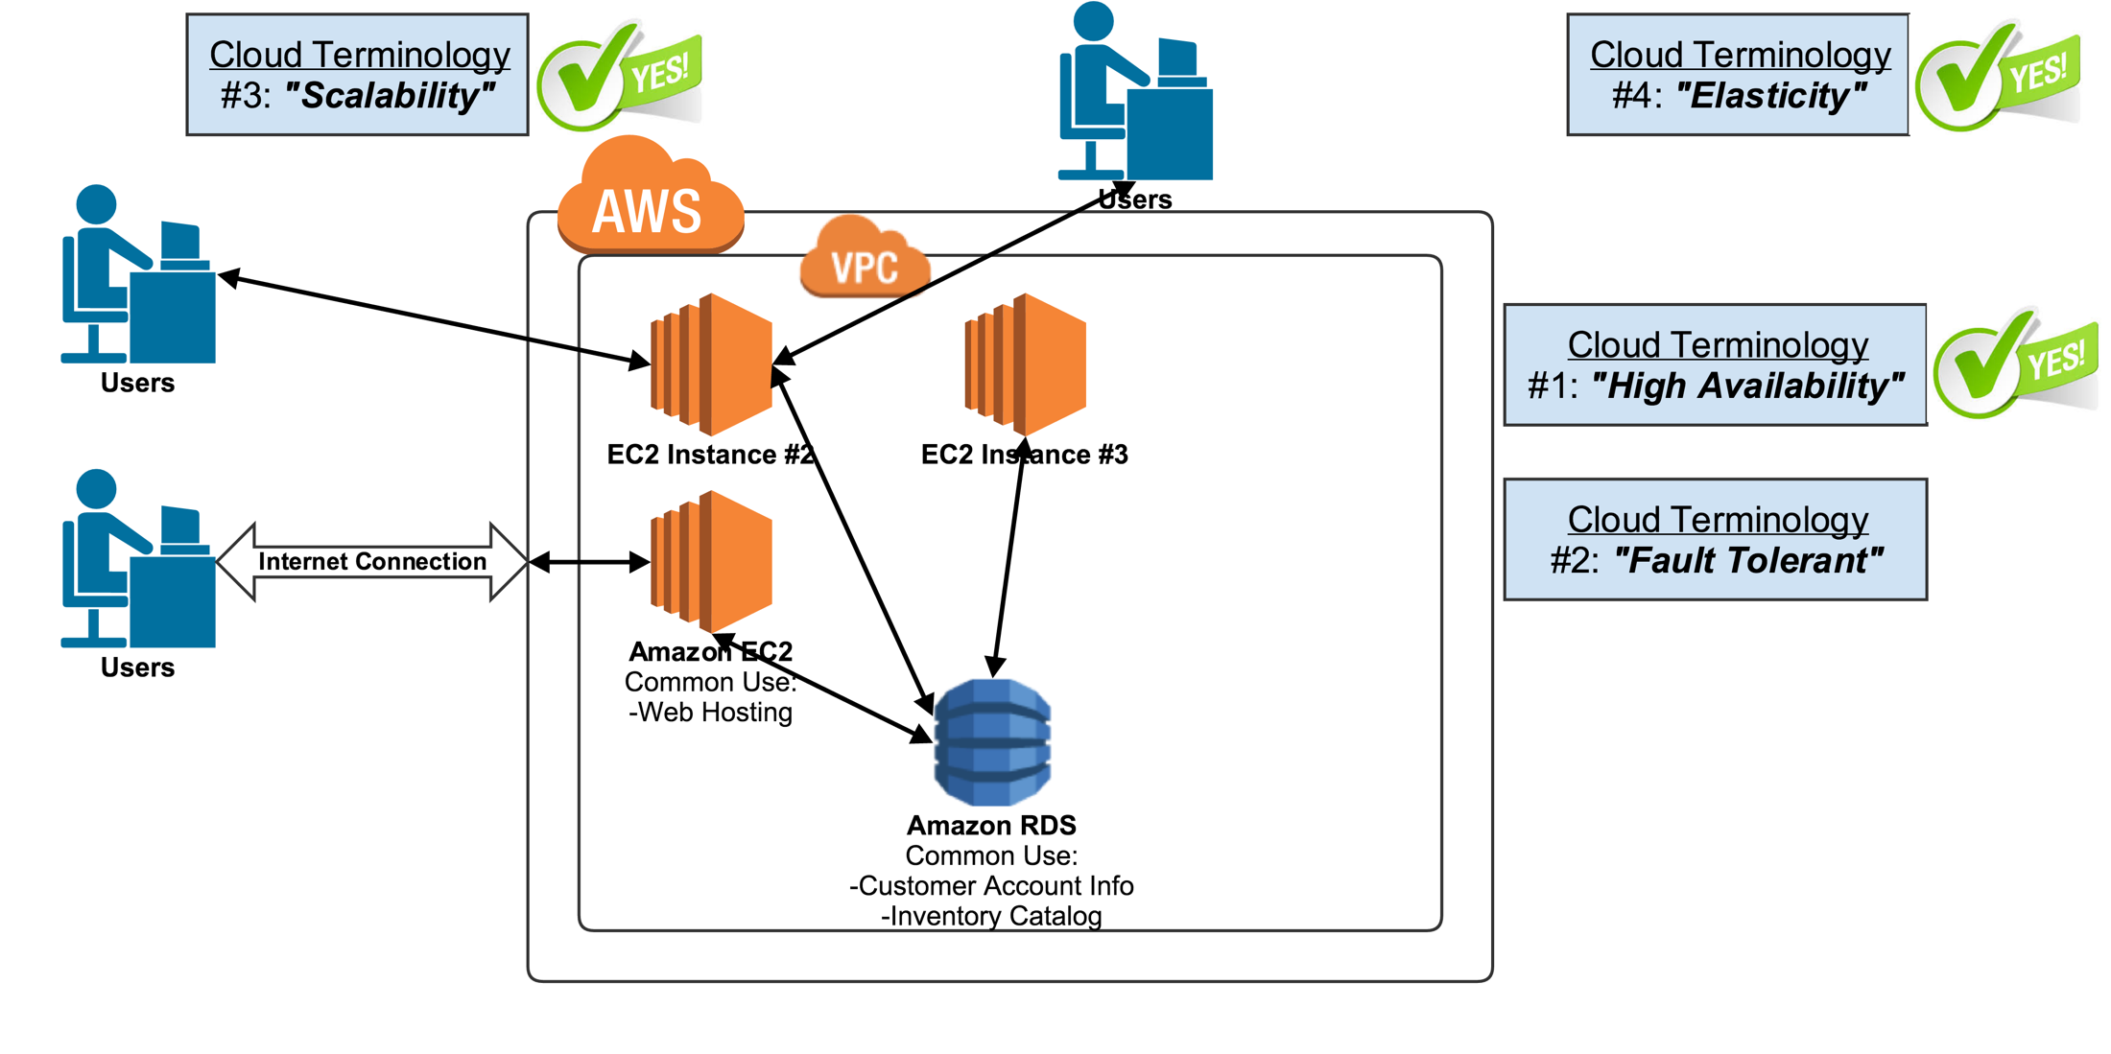
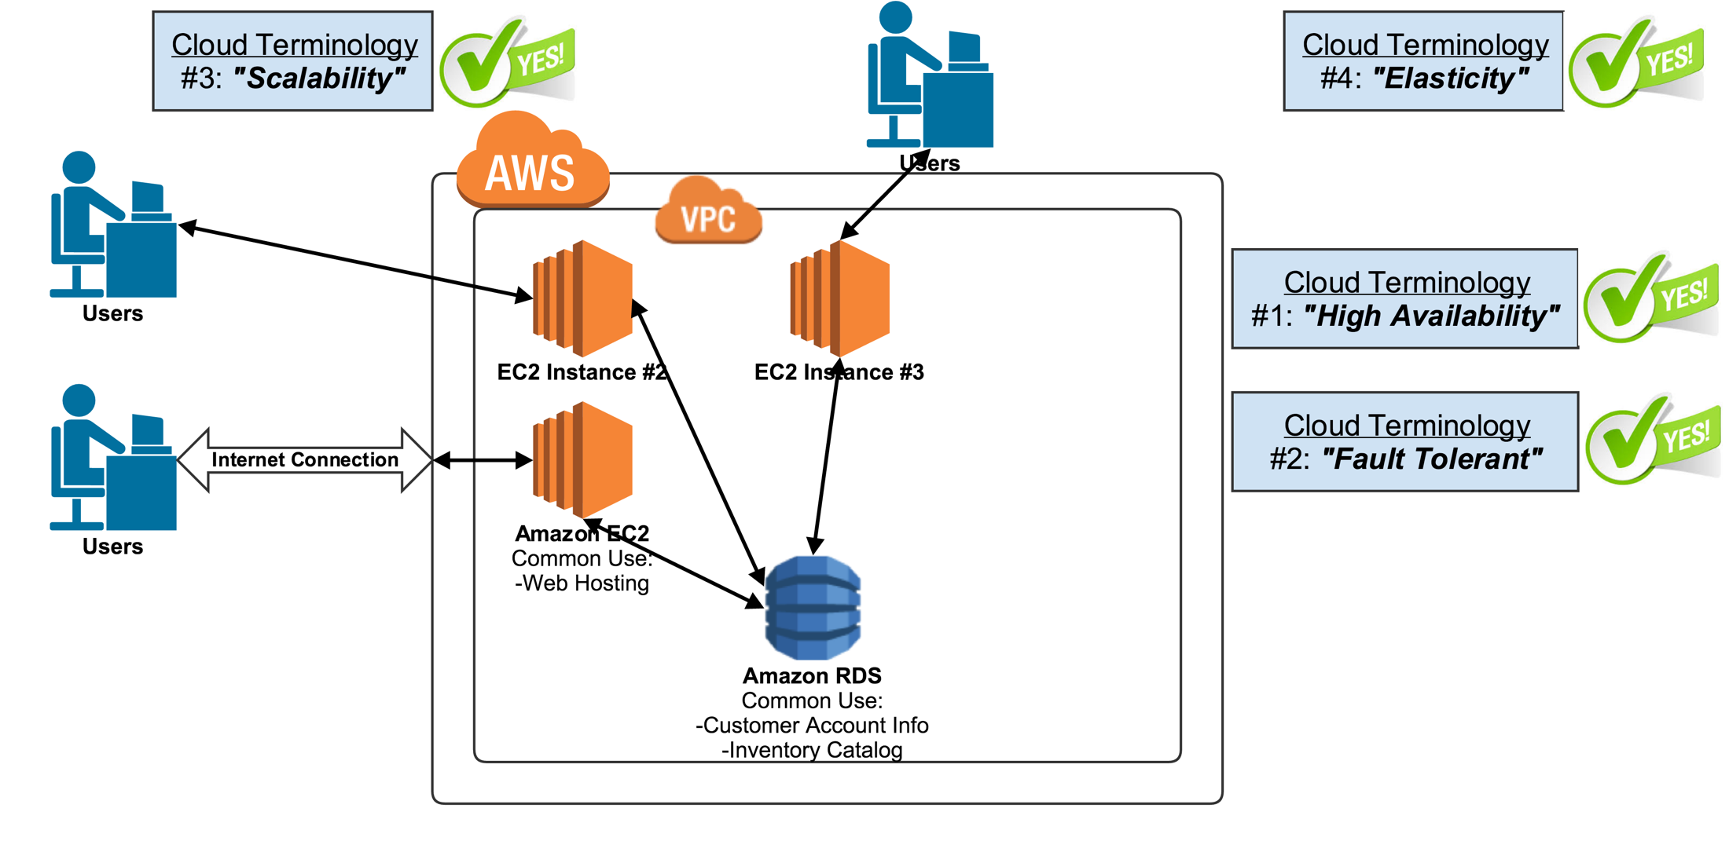
High Availability & Fault Tolerant

Slide 27
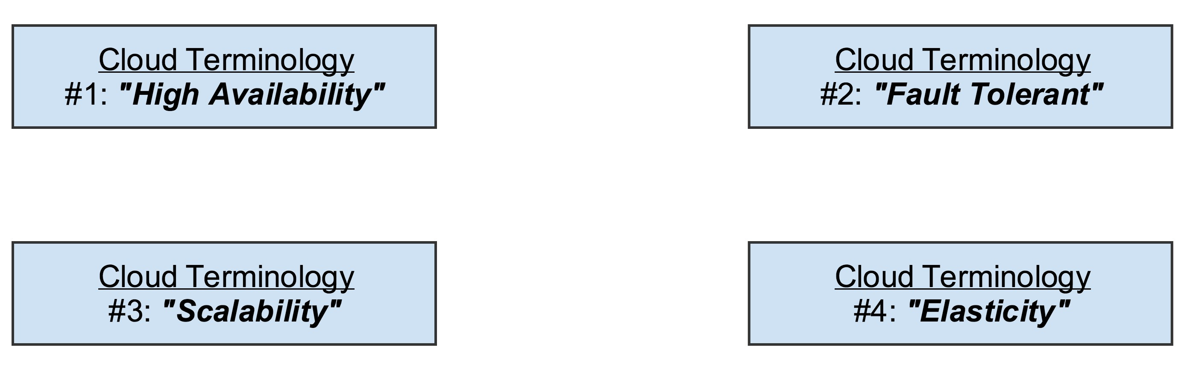
Conclusion
RDS is AWS provisioned database service.
Commonly used for things like storing customer account information and cataloging inventory.
Your files are always available always accessible websites are always accessible fault tolerant.
If something happens to crash or go wrong it will fix itself scalability the ability to as users or demand increase.
You can add more servers to cover that increase in demand and elasticity being the ability once that demand subsides or reduces you can scale down or back quickly thus saving you money and not having to lay out upfront money to buy hardware to install on your on premise data center.

Slide 28
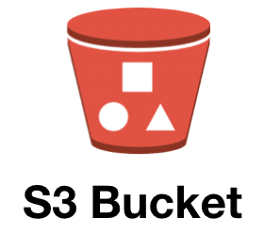
Section # 2
Introduction to AWS Terminologies
S3

Slide 29
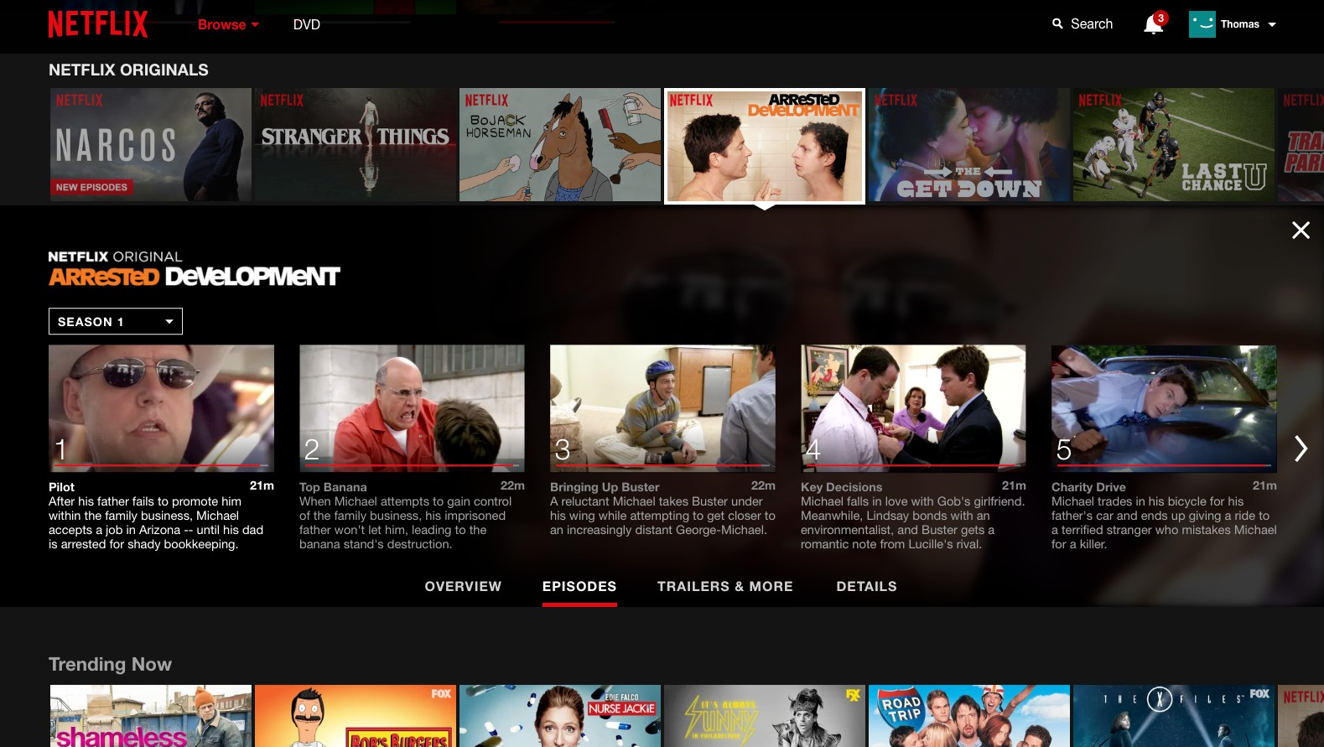
S3 (Simple Storage Service)
Lets dive into where Netflix actually stores the thousands upon thousands if not tens of thousands if not even more of actual video files that power their content.
So episode one episode to episode three.
There have to be those video files multiple versions of them stored somewhere.
And this is where S3 comes into play.
Amazon S3 is the storage platform of AWS.

Slide 30
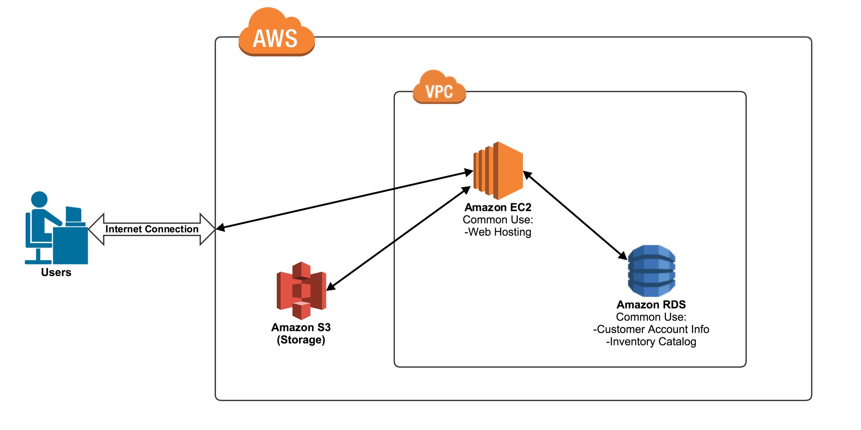
Netflix
S3 (Simple Storage Service)
Amazon S3 is basically just a large unlimited storage bucket.
Obviously there is a limit in there somewhere but that limit is so unbelievably high
S3 is a perfect place for any documents movies music applications pictures anything that you have that you want to store.
You can drop into S3 and it is going to be there for as long as you'd like.
And it's going to be multiple redundancies and backups of the files that you put there.
You're always going to have high availability of any files that you decide to store in S3.

Slide 31
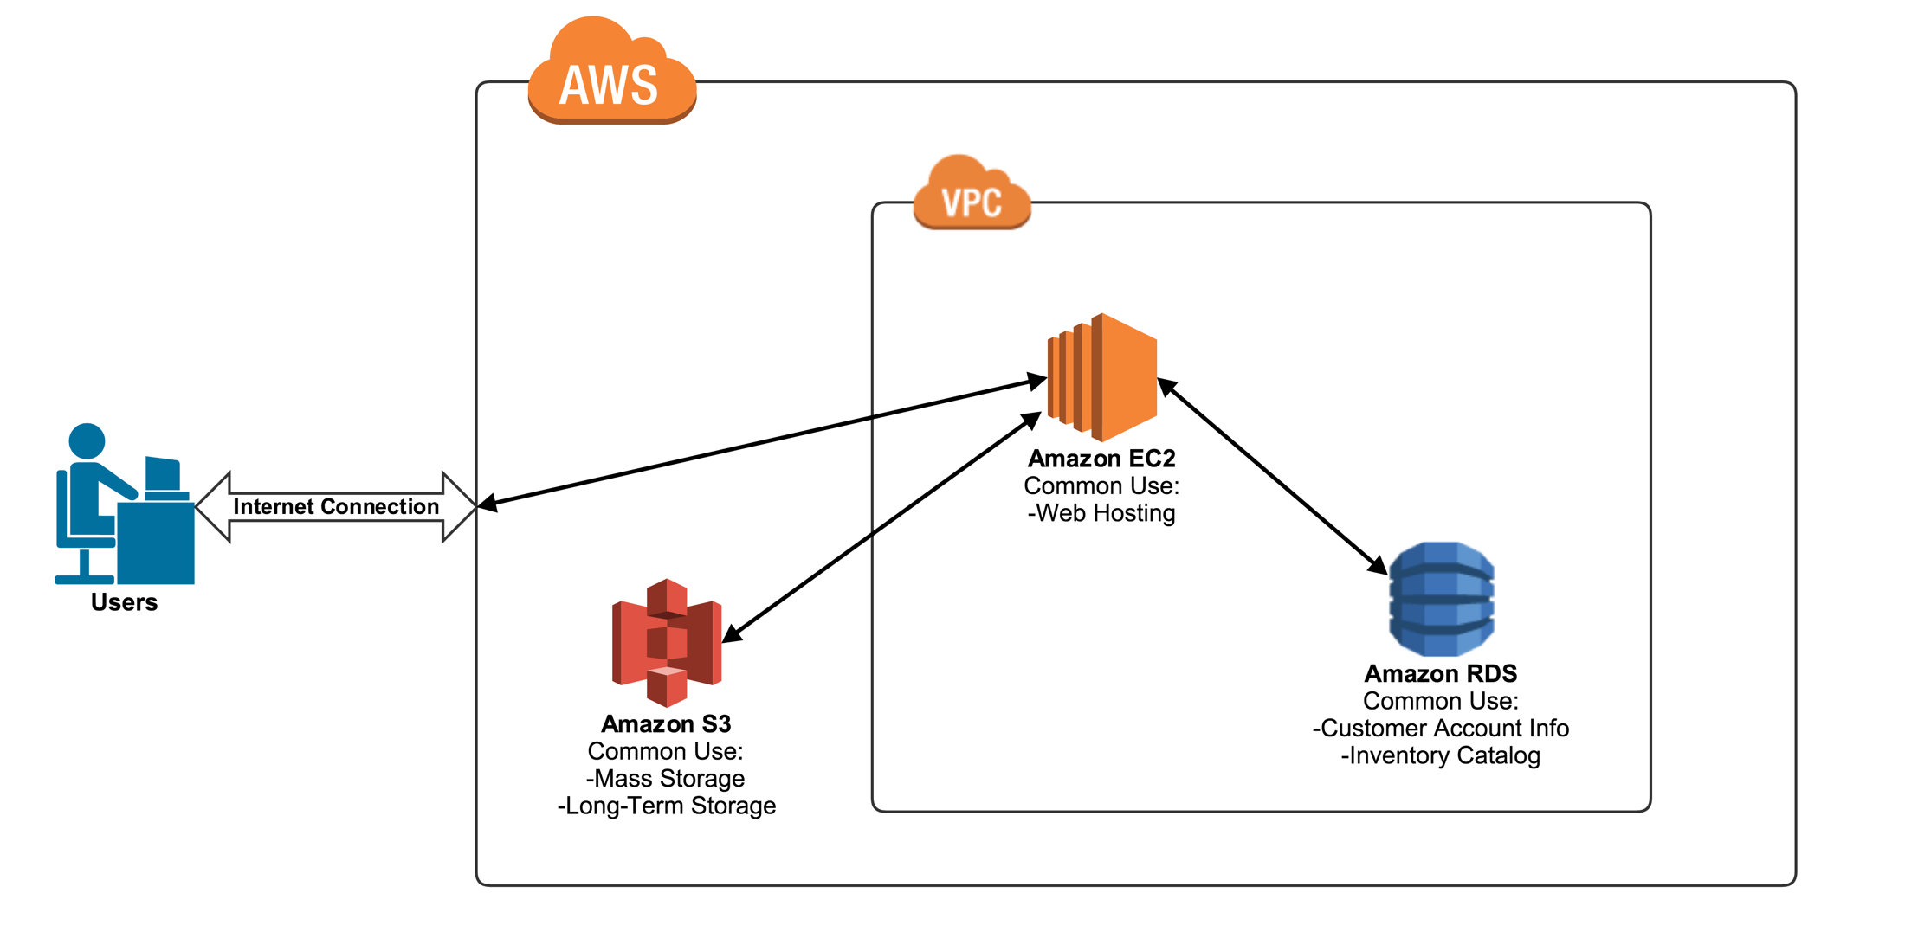
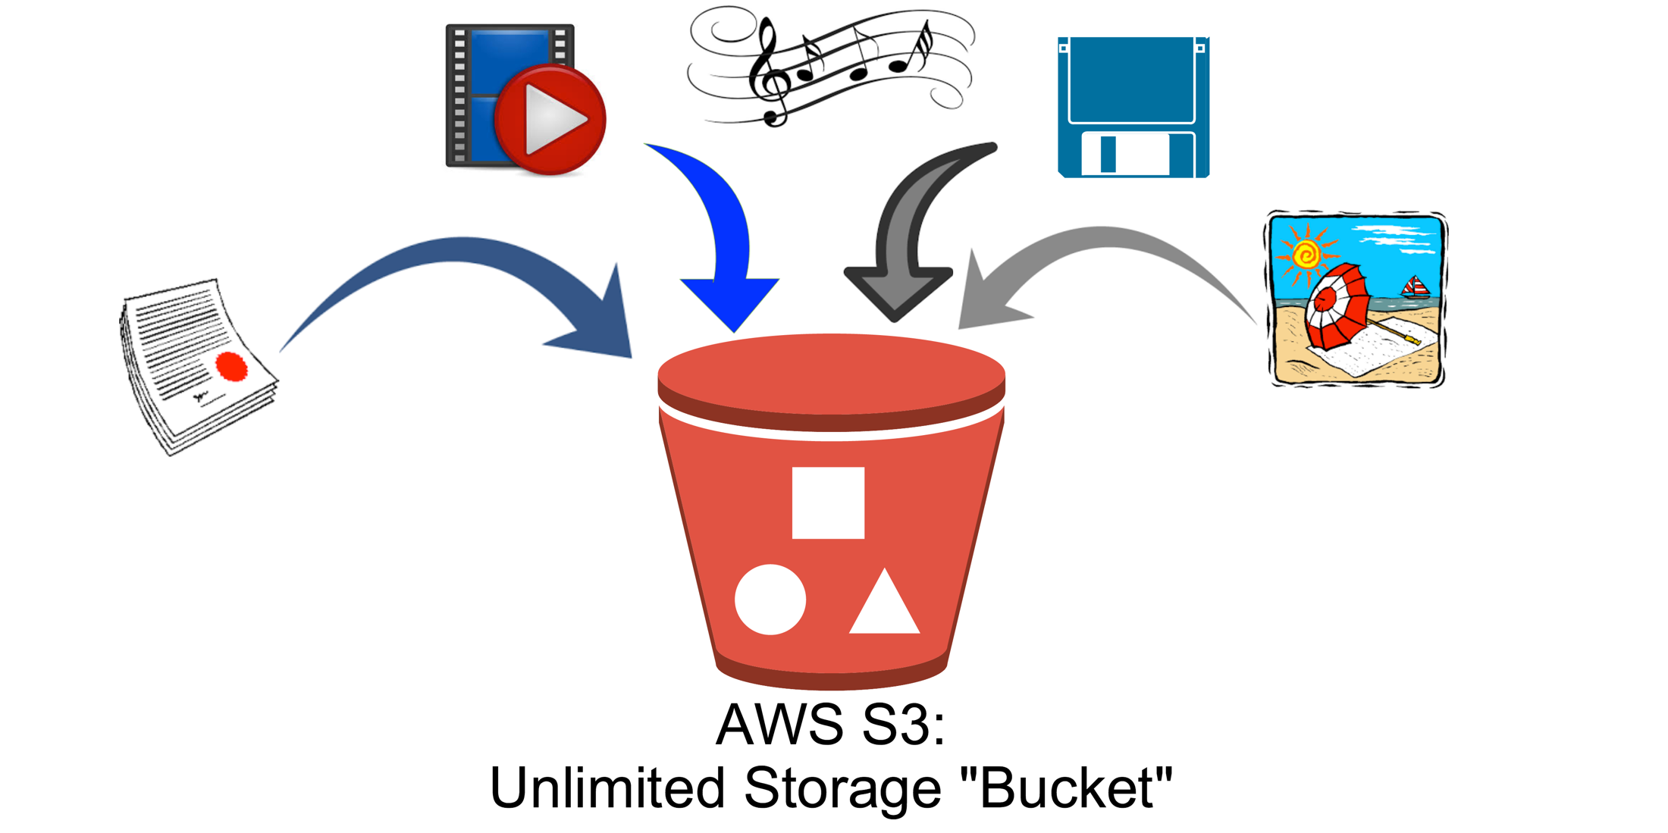
Netflix
S3 Analogy
Dropbox actually is just a nice user interface that is backed up with S3 stores
When you upload a file to Dropbox you're actually just putting your file into an Amazon S3 bucket

Slide 32
Conclusion
Amazon S3 and one of the it's just a mass storage container.
It is also great for long term storage.
Amazon S3 is where Netflix stores the Petabytes upon petabytes of video files that they have to store

Slide 33
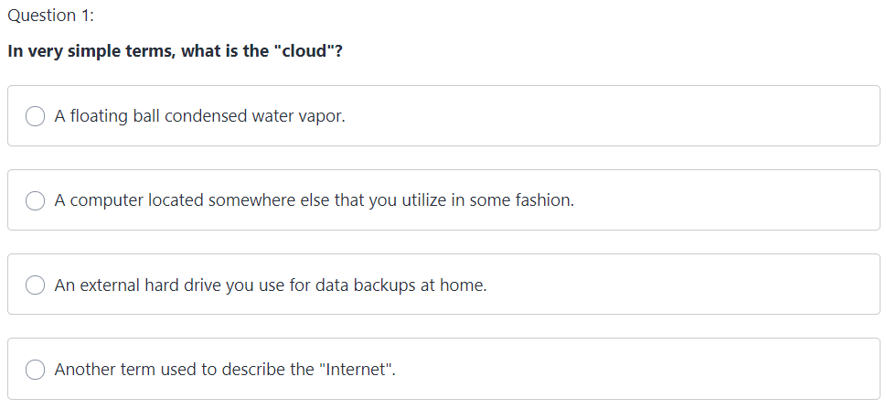
Quiz

Slide 34
Quiz

Slide 35
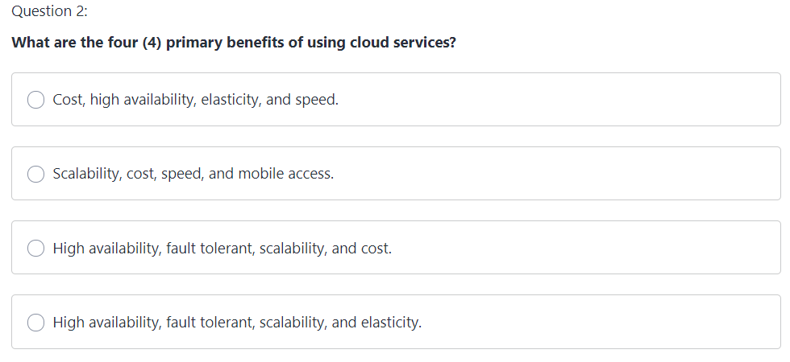
Quiz

Slide 36
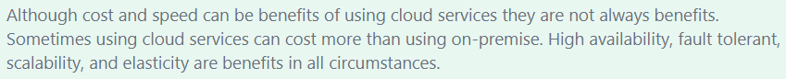
Quiz

Slide 37
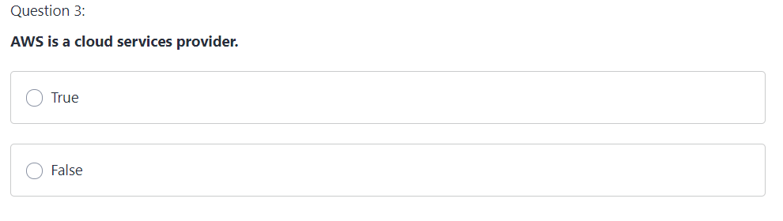
Quiz

Slide 38
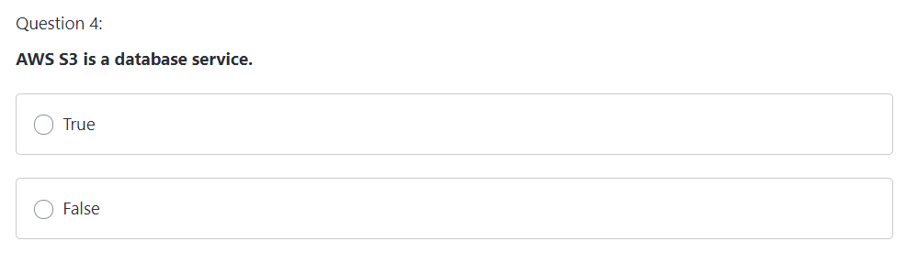
Quiz

Slide 39
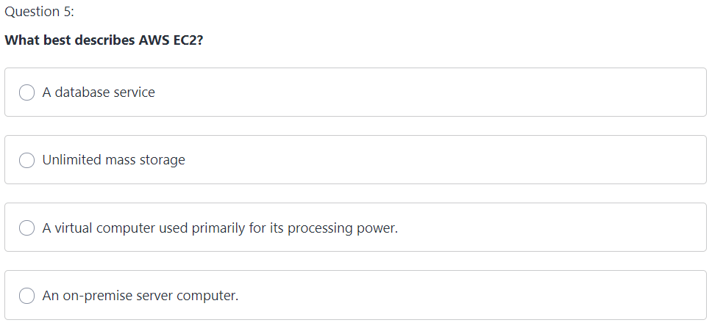
Quiz

Slide 40
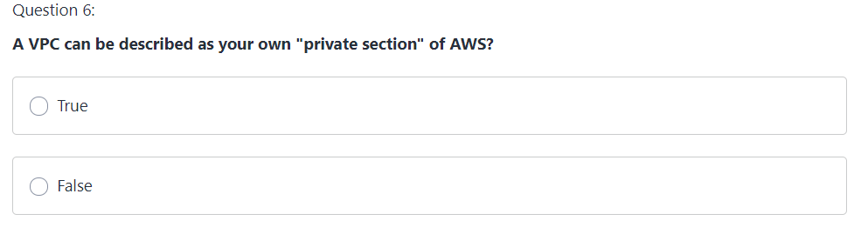
Quiz

Slide 41
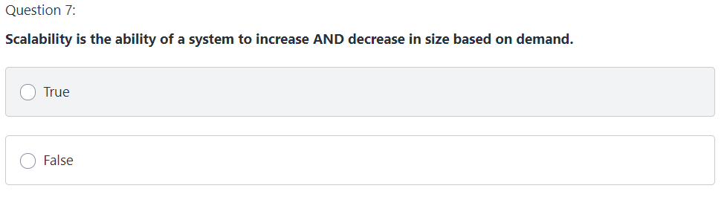
Quiz

Slide 42
Quiz

Slide 43
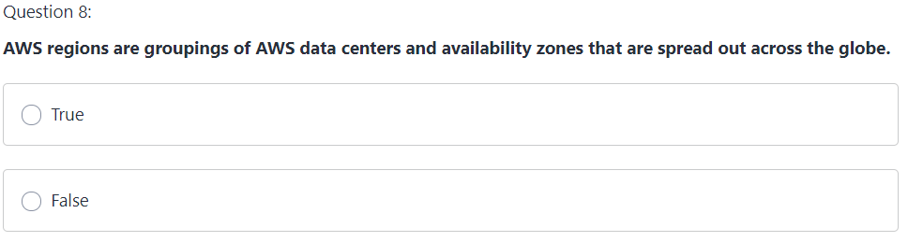
Quiz

Slide 44
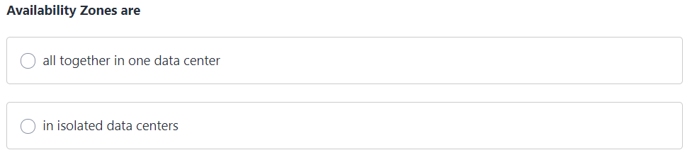
Quiz
Question 9:

